Slide 1

CSE299.1 – GROUP 2 – WEEKLY UPDATE
TRAVELLER
September 07, 2020
SHAZID HASAN RIAM - 162 1060 042
SIDRATUL MUNTAHA TAJ – 173 1905 642

Slide 2
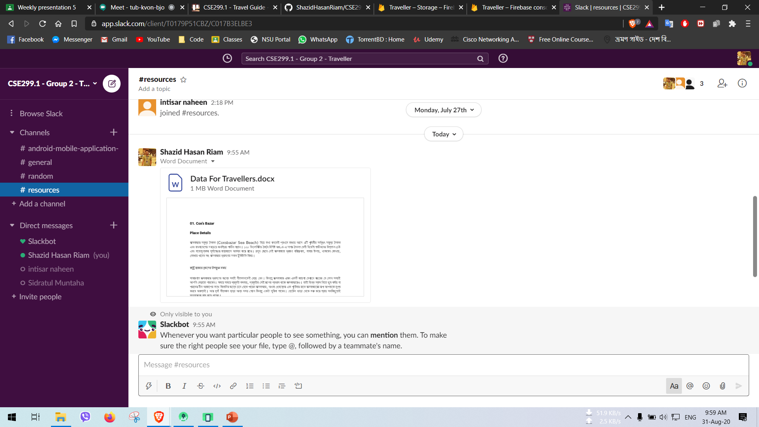
SLACK

Slide 3
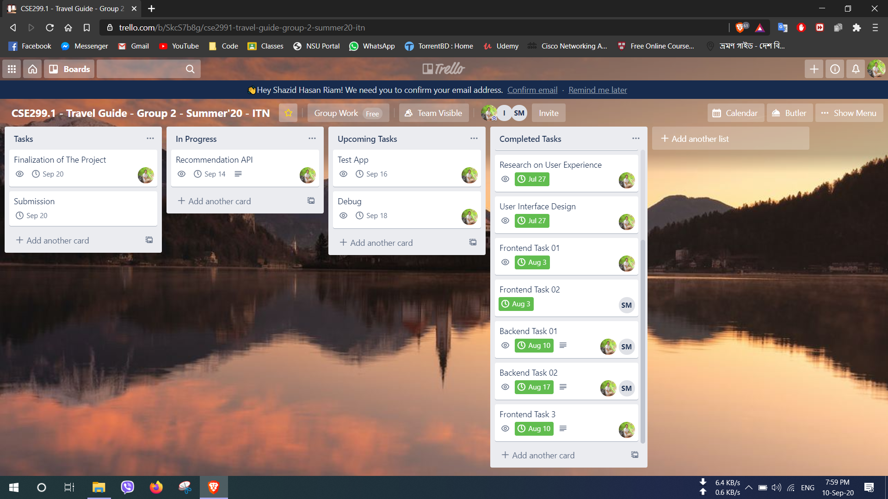
TRELLO

Slide 4
Featured Added
Added 20 New Places
Bookmark Button is working

Slide 5
THANK YOU

